Slide 1
BCT 2083 DISCRETE STRUCTURE AND APPLICATIONS
CHAPTER 2
ADVANCE COUNTING TECHNIQUE
SITI ZANARIAH SATARI
FSTI/FSKKP UMP I1011
Notes:
BCT2083 DISCRETE STRUCTURE & APPLICATIONS
CHAPTER 2

Slide 2

CHAPTER 2 ADVANCE COUNTING TECHNIQUE
CONTENT
    2.1 Recurrence Relations
    2.2 Solving Recurrence Relations
    2.3 Divide-and-Conquer Relations
    2.4 Generating Functions
    2.5 Inclusion-Exclusion
    2.6 Application of
    Inclusion-Exclusion
Notes:
BCT2083 DISCRETE STRUCTURE & APPLICATIONS
CHAPTER 2

Slide 3


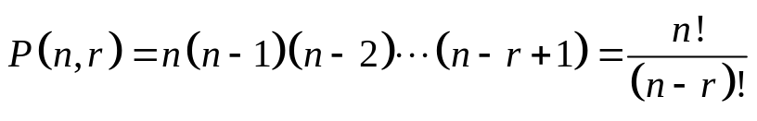
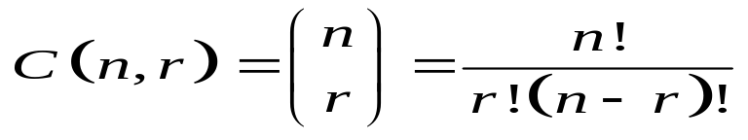
CHAPTER 2 ADVANCE COUNTING TECHNIQUE
RECALL – Counting technique
Number of ways = n1n2 ··· nm
  Product rule
  Sum rule
  The Inclusion-Exclusion Principle
  Tree Diagrams
  The Pigeonhole Principle
  Permutations
  Combinations
Number of ways = n1 + n2 +…+ nm
If N objects are placed into k boxes, then there is at least one box containing at least objects.
Notes:
BCT2083 DISCRETE STRUCTURE & APPLICATIONS
CHAPTER 2

Slide 4

2.1 RECURRENCE RELATIONS
CHAPTER 2 ADVANCE COUNTING TECHNIQUE
Define and develop a recurrence relation
Model a problem using recurrence relation
Find the solution of recurrence relations
with the given initial conditions
Notes:
BCT2083 DISCRETE STRUCTURE & APPLICATIONS
CHAPTER 2

Slide 5
2.1 RECURRENCE RELATION
Motivation
  The number of bacteria in a colony doubles every hour. If the colony begins with 5 bacteria, how many will be present in n hours?
  Let an : the number of bacteria at the end of n hours
  Then;
  an = 2an-1, a0=5
  What we are doing actually?
  We find a formula/model for an (the relationship between an and a0) – this is called recurrence relations between the term of sequence.
Solution:
By using recursive definition
Since bacteria double every hour Initial condition
Notes:
BCT2083 DISCRETE STRUCTURE & APPLICATIONS
CHAPTER 2

Slide 6
2.1 RECURRENCE RELATION
Recursive (Inductive) Definitions
Recursion – a process to define an object explicitly
The object can be a sequence, function or set (for BCT2078 purposes)
The ideas – construct new elements from known elements.
Process – specify some initial elements in a basis step and provide a rule for constructing new elements from those we already have in the recursive step.
Mathematical Induction can be used to prove the result.
The given complex problem
Can be
solved if
This simple version can be solved
Can be
solved if
Can be
solved if
This simple version can be solved
  an = 2an-1 an-1 = 2an-2, a1 = 2a0, a0=5
Notes:
BCT2083 DISCRETE STRUCTURE & APPLICATIONS
CHAPTER 2

Slide 7
2.1 RECURRENCE RELATION
Recurrence Relation
A recurrence relation for the sequence {an} is an equation that expresses an in terms of one or more of the previous terms of the sequence, namely, a0, a1,…, an-1, for all integers n with n ≥ n0, where n0 is a nonnegative integer.
A sequence is call solution of a recurrence relation if its term satisfy the recurrence relation.
an = 2an-1
a0 = 5
Recurrence relation
Recursive
definition
Initial condition
A recursive algorithm provides the solution of a problem of size n in term of
the solutions of one or more instances of the same problem in smaller size.
The initial condition specify the terms that precede the first term where
the recurrence elation takes effect.
Notes:
BCT2083 DISCRETE STRUCTURE & APPLICATIONS
CHAPTER 2

Slide 8
2.1 RECURRENCE RELATION
Example 2.1.1
Let {an} be a sequence that satisfies the recurrence relation an = an-1 – an-2 for n = 2, 3,4, and suppose that a0 =3 and a1 = 5.
List the first four term.
a0 = 3
a1 = 5
a2 = a1 – a0 = ___________________
a3 = __________________________
What is a5?
a5 = __________________________
Notes:
BCT2083 DISCRETE STRUCTURE & APPLICATIONS
CHAPTER 2

Slide 9
2.1 RECURRENCE RELATION
Example 2.1.2
Determine whether {an} where an = 3n for every nonnegative integer n, is a solution of recurrence relation an = 2an-1 – an-2 for n = 2, 3, 4, …
Suppose that an = 3n for every nonnegative integer n, Then for n ≥ 2;
2an-1 – an-2 = ___________________
Therefore,
Determine whether {an} where an = 5 for every nonnegative integer n, is a solution of recurrence relation an = 2an-1 – an-2 for n = 2, 3, 4, …
2an-1 – an-2 = ___________________
Notes:
BCT2083 DISCRETE STRUCTURE & APPLICATIONS
CHAPTER 2

Slide 10
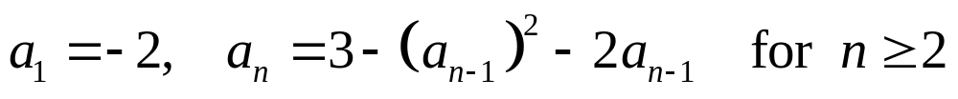
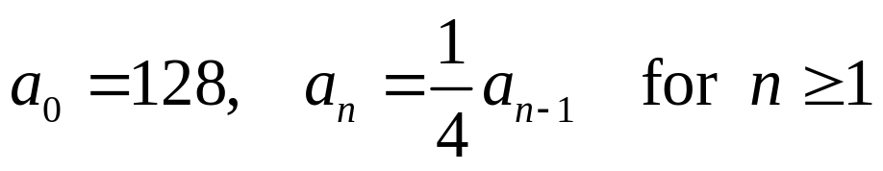
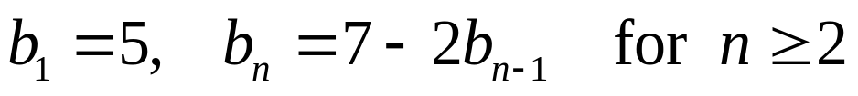
2.1 RECURRENCE RELATION
EXERCISE 2.1
Let an denotes the nth term of a sequence satisfying the given initial condition (s) and the recurrence relation. Compute the first four terms of the sequence.
A
B
C
D
E
Notes:
BCT2083 DISCRETE STRUCTURE & APPLICATIONS
CHAPTER 2

Slide 11
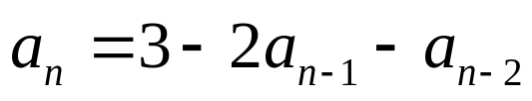
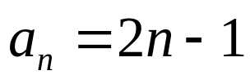
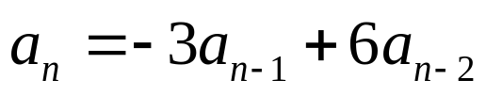
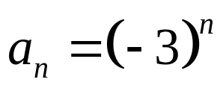
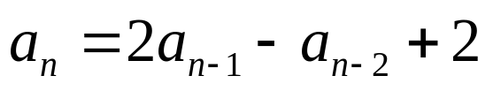
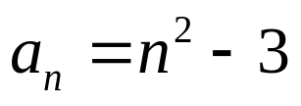
2.1 RECURRENCE RELATION
EXERCISE 2.1
Is the sequence {an} a solution of the if
Is the sequence {an} a solution of the if
Show that the sequence {an} is a solution of the recurrence
relation if
Notes:
BCT2083 DISCRETE STRUCTURE & APPLICATIONS
CHAPTER 2

Slide 12
2.1 RECURRENCE RELATION
Modeling with Recurrence Relation
We can use recurrence relation to model a wide variety of problems such as
  Finding a compound interest
  Counting a population of rabbits
  Determining the number of moves in the Tower of Hanoi puzzle
  Counting bit strings
Notes:
BCT2083 DISCRETE STRUCTURE & APPLICATIONS
CHAPTER 2

Slide 13
2.1 RECURRENCE RELATION
Example 2.1.3: Compound interest
Suppose that a person deposits RM10,000 in a savings account at a bank yielding 11% per year with interest compounded annually. Define recursively the compound amount in the account at the end of n years.
  Let an : the amount in the account after n years
  Then;
  an = (compound amount at the end of (n -1)th years)
  + (interest for the nth years)
  an = an-1 + 0.11an-1
  = 1.11 an-1
  With initial condition; a0 = 10,000
Solution:
Notes:
BCT2083 DISCRETE STRUCTURE & APPLICATIONS
CHAPTER 2

Slide 14
2.1 RECURRENCE RELATION
Example 2.1.4: Population of rabbits
A young pair of rabbits (one of each sex) is placed on an island. A pair of rabbits does not breed until they are 2 months old. After they are 2 months old, each pair of rabbits produces another pair each month. Find a recurrence relation for the numbers of pairs of rabbits on the island after n months if all the rabbits alive.
  Let fn : the numbers of pairs of rabbits on the island after n months
  Then;
  fn = (number of pairs of rabbits in (n -1)th months)
  + (number of newborn pairs of rabbits)
  fn = fn-1 + fn-2
  With initial condition; f1 = 1 and f2 = 1 ; n ≥ 3
Solution:
WHY???
[Problem develop by Leonardo Pisano (Liber abaci, 13th century) – lead to Fibonacci number]
Notes:
BCT2083 DISCRETE STRUCTURE & APPLICATIONS
CHAPTER 2

Slide 15
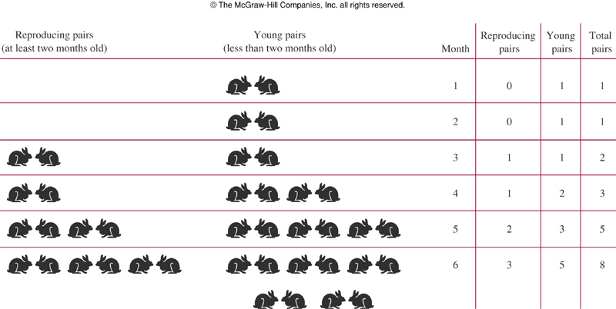
2.1 RECURRENCE RELATION
Example 2.1.4: Population of rabbits
Notes:
BCT2083 DISCRETE STRUCTURE & APPLICATIONS
CHAPTER 2

Slide 16
2.1 RECURRENCE RELATION
Example 2.1.5: Tower of Hanoi
Popular Puzzle invented by Edouard Lucas
(French Mathematician, late 19th century)
RULES OF PUZZLE:
  Suppose we have 3 pegs labeled A, B, C and a set of disks of different sizes.
  These disks are arranged from the largest disk at the bottom to the smallest disk at the top (1 to n disks) on peg A.
  The goal: to have all disks on peg C in order of size, with the largest on the bottom.
  Only one disk is allow to move at a time from a peg to another.
  Each peg must always be arranged from the largest at the bottom to the smallest at the top
Notes:
BCT2083 DISCRETE STRUCTURE & APPLICATIONS
CHAPTER 2

Slide 17
2.1 RECURRENCE RELATION
Example 2.1.5: Tower of Hanoi
ILLUSTRATION: SOLUTION
Let Hn :
the numbers of
moves with n disks
n disks
A
B
C
Initial Position in the Tower of Hanoi
n-1 disks
transfer the top of
n-1 disks to peg B
A
B
C
Hn-1 moves
Intermediate Position in the Tower of Hanoi
Notes:
BCT2083 DISCRETE STRUCTURE & APPLICATIONS
CHAPTER 2

Slide 18
2.1 RECURRENCE RELATION
Example 2.1.5: Tower of Hanoi
ILLUSTRATION: SOLUTION
Moves the largest
disk to peg C
1 disks
1 move
A
B
C
Intermediate Position in the Tower of Hanoi
n disks
transfer the top of
n-1 disks to peg B
A
B
C
Hn-1 moves
Last Position in the Tower of Hanoi
Notes:
BCT2083 DISCRETE STRUCTURE & APPLICATIONS
CHAPTER 2

Slide 19
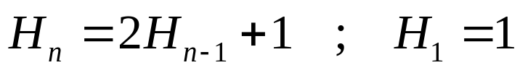
2.1 RECURRENCE RELATION
Example 2.1.5: Tower of Hanoi
Solution (continue):
Thus the number of moves is given by:
Where:
transfer the top of
n-1 disks to peg B
Moves the largest
disk to peg C
transfer the top of
n-1 disks to peg B
Hn-1 moves
+
1 move
+
Hn-1 moves
Notes:
BCT2083 DISCRETE STRUCTURE & APPLICATIONS
CHAPTER 2

Slide 20
2.1 RECURRENCE RELATION
Example 2.1.6: Bit Strings
Find a recurrence relation and give initial conditions for the number of bit strings of length n that do not have two consecutive 0s. How many bit strings are there of six length?
  Let an : number of bit strings of length n that do not have two
  consecutive 0s
  Then;
  an = (number of bit strings of length n-1 that do not have
  two consecutive 0s)
  + (number of bit strings of length n-2 that do not have
  two consecutive 0s)
  an = an-1 + an-2 ; n ≥ 3
  With initial condition;
  a1 = 2, both strings of length 1 do not have consecutive 0s ( 0 and 1)
  a2 = 3, the valid strings only 01, 10 and 11
Solution:
Solve yourself
Notes:
BCT2083 DISCRETE STRUCTURE & APPLICATIONS
CHAPTER 2

Slide 21
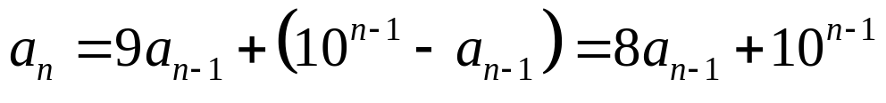
2.1 RECURRENCE RELATION
Example 2.1.7: Codeword enumeration
A computer system considers a string of decimal digits a valid codeword if it contains an even number of 0 digits. For instance, 1230407869 is valid, whereas 120987045608 is not valid. Let an be the number of valid n-digit codewords. Find a recurrence relation for an.
  Let an : the number of valid n-digit codewords
  Then;
  an = (number of valid n-digit codewords obtained by adding a
  digit other than 0 at the end of a valid string of length n – 1)
  + (number of valid n-digit codewords obtained by adding a
  digit 0 at the end of an invalid string of length n – 1)
  With initial condition;
  a1 = 9, there are 10 one-digit strings and only one the string 0 not valid
Solution:
Notes:
BCT2083 DISCRETE STRUCTURE & APPLICATIONS
CHAPTER 2

Slide 22




2.1 RECURRENCE RELATION
Example 2.1.7: Codeword enumeration
  A valid codeword of length n can be formed by:
  A) Adding a digit other than 0 at the end of a valid string of length n – 1
  - This can be done in nine ways. Hence, a valid string with n digits can
  be formed in this manner in ways.
  B) Adding a digit 0 at the end of an invalid string of length n – 1
  - This produces a string with an even number of 0 digits because the invalid string of length n – 1 has an odd number of 0 digits. The number of ways that this can be done equals the number of invalid (n – 1)-digit strings. Because there are strings of length n – 1, and are valid, then there are invalid (n – 1)-digit strings.
  Thus;
Notes:
BCT2083 DISCRETE STRUCTURE & APPLICATIONS
CHAPTER 2

Slide 23
2.1 RECURRENCE RELATION
EXERCISE 2.1
Define recursively : 1, 4, 7, 10, 13, …
Judy deposits RM1500 in a local savings bank at an annual interest rate of 8% compounded annually. Define recursively the compound amount an she will have in her account at the end of n years. How much will be in her account after 3 years?
There are n students at a class. Each person shakes hands with everybody else exactly one. Define recursively the number of handshakes that occur.
Notes:
BCT2083 DISCRETE STRUCTURE & APPLICATIONS
CHAPTER 2

Slide 24
2.1 RECURRENCE RELATION
EXERCISE 2.1
Find a recurrence relation and initial condition for the number of ways to climb n stairs if the person climbing the stairs can take one, two or three stairs at a time. How many ways can this person climb a building with eight stairs?
Find a recurrence relation and initial condition for the number of bit strings of length n that contain three consecutive 0s. How many bit strings of length seven contain three consecutive 0s?
Find a recurrence relation for the number of bit sequences of length n with an even number of 0s?
Notes:
BCT2083 DISCRETE STRUCTURE & APPLICATIONS
CHAPTER 2

Slide 25
2.1 RECURRENCE RELATION
EXERCISE 2.1 : EXTRA
  PAGE : 456, 457, 458, 459 and 460
  Rosen K.H., Discrete Mathematics & Its Applications, (Seventh Edition), McGraw-Hill, 2007.
Notes:
BCT2083 DISCRETE STRUCTURE & APPLICATIONS
CHAPTER 2

Slide 26
CHAPTER 2 ADVANCE COUNTING TECHNIQUE
2.2 SOLVING RECURRENCE RELATION
Solve a recurrence relation using iterative
method
Solve a linear homogeneous recurrence
relation with constant coefficients
Solve a linear nonhomogeneous recurrence
relation with constant coefficients
Notes:
BCT2083 DISCRETE STRUCTURE & APPLICATIONS
CHAPTER 2

Slide 27
2.2 SOLVING RECURRENCE RELATION
Iterative Method
Solving the recurrence relation for a function f means finding an explicit formula for f (n). The iterative method of solving it involves two steps:
  Apply the recurrence formula iteratively and look for the pattern to predict an explicit formula
    Forward: start from a0 to an
    Backward : start from an to a0
  Use Induction to prove that the formula does indeed hold for every possible value of the integer n.
Notes:
BCT2083 DISCRETE STRUCTURE & APPLICATIONS
CHAPTER 2

Slide 28
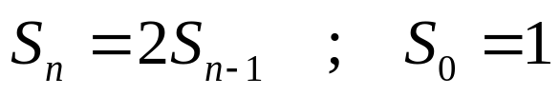
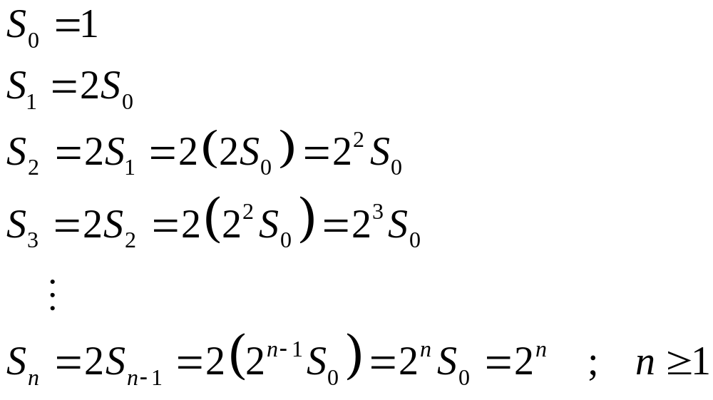
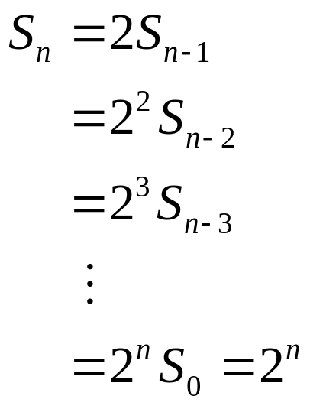
2.2 SOLVING RECURRENCE RELATION
Example 2.2.1 (a): Iterative Method
Using the iterative method, predict a solution for the following recurrence relation with the given initial condition.
Solution: (FORWARD)
Solution: (BACKWARD)
Notes:
BCT2083 DISCRETE STRUCTURE & APPLICATIONS
CHAPTER 2

Slide 29
2.2 SOLVING RECURRENCE RELATION
Recall: Mathematical Induction
Objective: To proof that the statement P(n) is true for each integer n ≥ n0
Steps:
1. Prove that the statement is true for n = n0.
2. Assume that the statement is true for n = k.
3. Prove that the statement is true for n = k + 1.
4. Conclusion: Therefore, the statement is true
for each integer n ≥ n0
Notes:
BCT2083 DISCRETE STRUCTURE & APPLICATIONS
CHAPTER 2

Slide 30
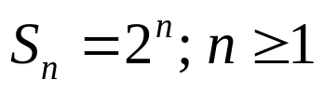

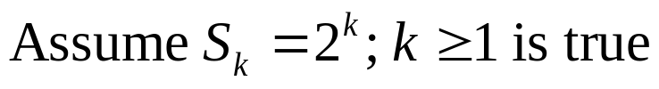
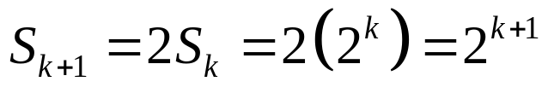
2.2 SOLVING RECURRENCE RELATION
Example 2.2.1 (b): Induction
Using induction, verify the solution for the recurrence relation
is given by .
Prove that the statement is true for n = n0.
Assume that the statement is true for n = k .
Prove that the statement is true for n = k + 1.
4. Conclusion: Therefore, the statement is true for each integer n ≥ n0
Solution:
Notes:
BCT2083 DISCRETE STRUCTURE & APPLICATIONS
CHAPTER 2

Slide 31
2.2 SOLVING RECURRENCE RELATION
Example 2.2.2: Compound interest
Suppose that a person deposits RM10,000 in a savings account at a bank yielding 11% per year with interest compounded annually. How much will be in the account after 30 years?
  Let an : the amount in the account after n years
  Then;
  an = (compound amount at the end of (n -1)th years)
  + (interest for the nth years)
  an = an-1 + 0.11an-1
  = 1.11 an-1 , n ≥ 1
  With initial condition; a0 = 10,000
Solution:
Notes:
BCT2083 DISCRETE STRUCTURE & APPLICATIONS
CHAPTER 2

Slide 32
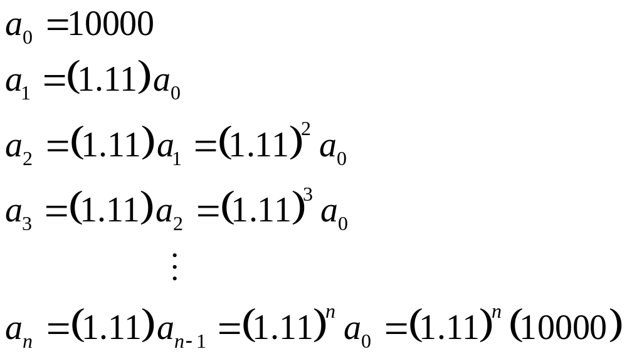
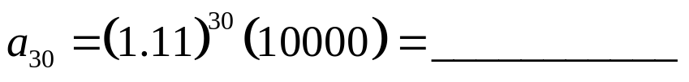
2.2 SOLVING RECURRENCE RELATION
Example 2.2.2: Compound interest
Solution (continue):
By iterative approach:
Thus, after 30 years the amount in the account will be:
PROVE BY INDUCTION !
Notes:
BCT2083 DISCRETE STRUCTURE & APPLICATIONS
CHAPTER 2

Slide 33
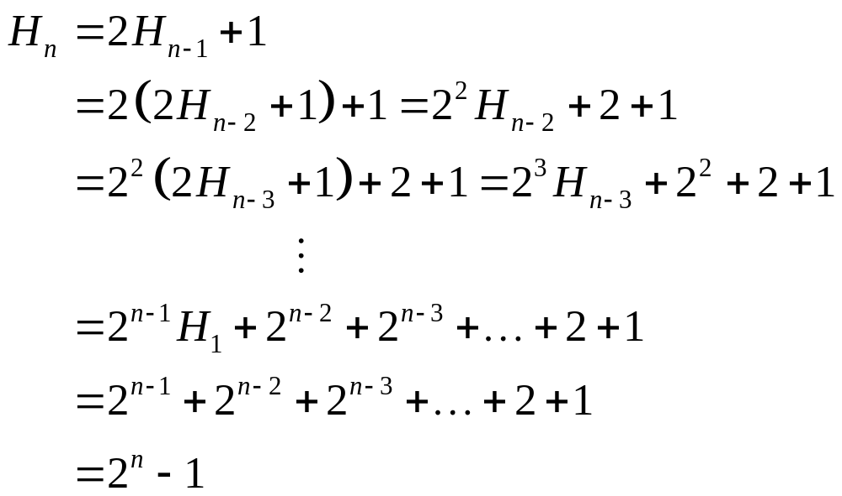
2.2 SOLVING RECURRENCE RELATION
Example 2.2.3: Tower of Hanoi
The number of moves is given by:
By iterative approach:
PROVE BY INDUCTION !
Notes:
BCT2083 DISCRETE STRUCTURE & APPLICATIONS
CHAPTER 2

Slide 34


2.2 SOLVING RECURRENCE RELATION
EXERCISE 2.2.1
Using iterative method, predict a solution to each of the following recurrence relation. Verify the solutions using induction
There are n students at a class. Each person shakes hands with everybody else exactly one. Define recursively the number of handshakes that occur. Solve this recurrence relation using iterative method and prove it using induction.
If a deposit of RM100 is made on the first day of each month into an account that pays 6% interest per year compounded monthly, show that the amount in the account after 18 years is RM 38929.
Notes:
BCT2083 DISCRETE STRUCTURE & APPLICATIONS
CHAPTER 2

Slide 35
2.2 SOLVING RECURRENCE RELATION
Linear Homogeneous Recurrence Relations with constant coefficients
A linear homogeneous recurrence relation of degree k with constant coefficients is a recurrence relation of the form
an = c1an-1 + c2an-2 + … + ckan-k
Where c1, c2,…, ck are real numbers and ck ≠ 0
Linear : The RHS is the sum of previous terms of the sequence each multiplied by a function of n.
Homogeneous : No terms occur that are not multiplies of the aj s.
Degree k : an is expressed in terms of the previous k terms of the sequence
Constant coefficients : c1, c2,…, ck
Recurrence relation : with k initial condition
a0 = C0, a1 = C1, … ak-1= Ck-1
Notes:
BCT2083 DISCRETE STRUCTURE & APPLICATIONS
CHAPTER 2

Slide 36
2.2 SOLVING RECURRENCE RELATION
Example 2.2.4: Linear Homogeneous RR
Linear Homogeneous Recurrence Relation
Pn = (1.11) Pn-1 degree one
fn = fn-1 + fn-2 degree two
an = an-5 degree five
Not Linear Homogeneous Recurrence Relation
Hn = 2Hn-1 + 1
Bn = nBn-1
an = an-1 + a²n-2
1. Often occur in modeling of problems
2. Can be systematically solved
Notes:
BCT2083 DISCRETE STRUCTURE & APPLICATIONS
CHAPTER 2

Slide 37
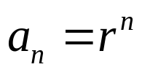




2.2 SOLVING RECURRENCE RELATION
Solving Linear Homogeneous Recurrence Relations with constant coefficients
OUR AIM – look for the solutions of the form , where r is constant.
Note that, is a solution of the recurrence relation an = c1an-1 + c2an-2 + … + ckan-k iff .
When both sides of this equation are divided by and the RHS is subtracted from the left, we obtain a characteristic equation:
The solution of this equation are called the characteristics roots.
Notes:
BCT2083 DISCRETE STRUCTURE & APPLICATIONS
CHAPTER 2

Slide 38

2.2 SOLVING RECURRENCE RELATION
Solving Linear Homogeneous Recurrence Relations with constant coefficients
Let c1, c2, …, ck be real numbers. Suppose that the characteristics equation
has k distinct roots r1, r2, …, rk.
Then a sequence {an} is a solution of the recurrence relation an = c1an-1 + c2an-2 + … + ckan-k iff for n ≥ 0 and α1, α2, …, αk constant.
If the characteristic equation has several (m) repeated roots, then the solution of the recurrence relation is given by:
Notes:
BCT2083 DISCRETE STRUCTURE & APPLICATIONS
CHAPTER 2

Slide 39


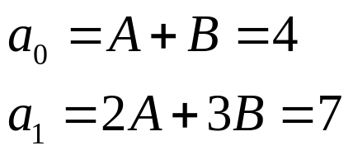
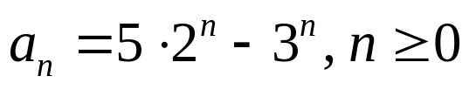
2.2 SOLVING RECURRENCE RELATION
Example 2.2.5: Second-Order LHRRWCCs
Solve the recurrence relation an = 5an-1 - 6an-2 where a0 = 4 and a1 = 7.
Find the general solution of the recurrence relation
  the characteristic equation is given by
  the characteristic roots are 2 and 3
  thus, the general solution is
Find the constant values, A and B using the initial conditions
  Solving the linear system: : A = 5, B = -1
Thus the solution to the recurrence relation and initial conditions is .
Solution:
Notes:
BCT2083 DISCRETE STRUCTURE & APPLICATIONS
CHAPTER 2

Slide 40


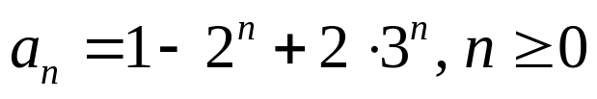
2.2 SOLVING RECURRENCE RELATION
Example 2.2.6: Higher-Order LHRRWCCs
Solve the recurrence relation an = 6an-1 - 11an-2 + 6an-3 where a0 = 2, a1 =5, and a2 = 15.
Find the general solution of the recurrence relation
  the characteristic equation is given by
  the characteristic roots are 1, 2 and 3
  thus, the general solution is
Find the constant values, A and B using the initial conditions
  Solving the linear system: (A = 1, B = -1, C = 2)
Thus the unique solution to the recurrence relation and initial conditions is .
Solution:
Notes:
BCT2083 DISCRETE STRUCTURE & APPLICATIONS
CHAPTER 2

Slide 41
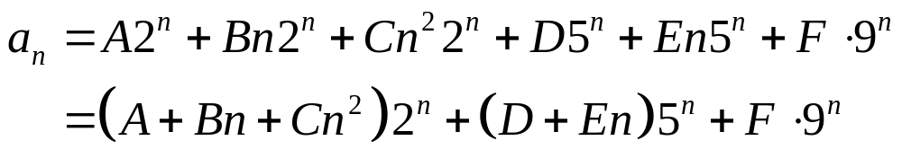
2.2 SOLVING RECURRENCE RELATION
Example 2.2.7: LHRRWCCs with multiple roots
Suppose that the roots of the characteristic equation of a linear homogenous recurrence relation are 2, 2, 2, 5, 5, and 9. What is the form of general solution?
Thus the general solution to the recurrence relation is
Solution:
Notes:
BCT2083 DISCRETE STRUCTURE & APPLICATIONS
CHAPTER 2

Slide 42



2.2 SOLVING RECURRENCE RELATION
EXERCISE 2.2.2
What is the solution of the following recurrence relation
Find an explicit formula for Fibonacci numbers.
Notes:
BCT2083 DISCRETE STRUCTURE & APPLICATIONS
CHAPTER 2

Slide 43



2.2 SOLVING RECURRENCE RELATION
Linear NonHomogenous Recurrence Relations with constant coefficients
A Linear Nonhomogenous recurrence relation with constant coefficients (LNHRRWCCs), that is a recurrence relation of the form an = c1an-1 + c2an-2 + … + ckan-k + F (n) .
Where
  c1, c2, …, ck are real numbers
  F (n) is a function not identically zero depending only n
  c1an-1 + c2an-2 + … + ckan-k is called the associated homogenous recurrence relation
Example:
Notes:
BCT2083 DISCRETE STRUCTURE & APPLICATIONS
CHAPTER 2

Slide 44
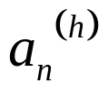
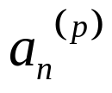
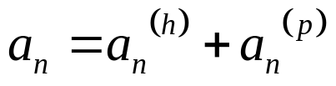
2.2 SOLVING RECURRENCE RELATION
Solving Linear NonHomogenous Recurrence Relations with constant coefficients
Let
be the general solution of c1an-1 + c2an-2 + … + ckan-k
And
be the particular solution of LNHRRWCCs,
an = c1an-1 + c2an-2 + … + ckan-k + F (n)
Then the general solution of LNHRRWCCs is given by
There is no general method to find the particular solution.
Notes:
BCT2083 DISCRETE STRUCTURE & APPLICATIONS
CHAPTER 2

Slide 45


2.2 SOLVING RECURRENCE RELATION
THEOREM 6
Suppose that {a_{n}} satisfy the linear nonhomogenous recurrence relation
And
When s is not a root of the characteristic equation, there is a particular solution of the form
(ii) When s is a root of the characteristic equation , there is a particular solution of the form
Notes:
BCT2083 DISCRETE STRUCTURE & APPLICATIONS
CHAPTER 2

Slide 46



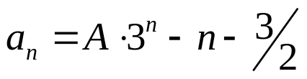
2.2 SOLVING RECURRENCE RELATION
Example 2.2.8: LNHRRWCCs
Find all the solutions of recurrence relation an = 3an-1 + 2n
Find the general solution of the associated linear homogenous (ALH) equation.
  the ALH equation is given by an = 3an-1
  thus, the general solution is
Find the particular solution
  Since F(n) = 2n is polynomial with degree 1, then the trial solution linear function: pn = cn + d (c and d are constant)
  The equation an = 3an-1 + 2n then become
  Solve for c and d will gives c = -1 and d = -3/2
  Thus, the particular solution is
Thus the unique solution to the recurrence relation is
Solution:
Notes:
BCT2083 DISCRETE STRUCTURE & APPLICATIONS
CHAPTER 2

Slide 47

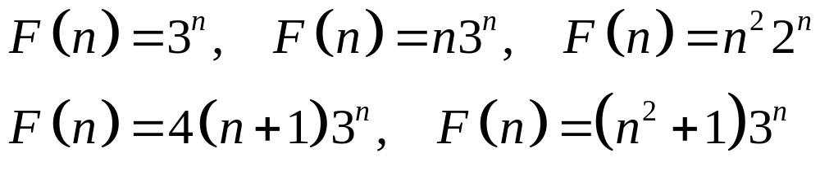
2.2 SOLVING RECURRENCE RELATION
EXERCISE 2.2.3
What is the solution of the following recurrence relation
What form does a particular solution of linear nonhomogeneous recurrence relation when
Notes:
BCT2083 DISCRETE STRUCTURE & APPLICATIONS
CHAPTER 2

Slide 48
2.2 SOLVING RECURRENCE RELATION
EXERCISE 2.2 : EXTRA
  PAGE : 456, 457, 458, 459 and 460
  471, 472, and 473
  Rosen K.H., Discrete Mathematics & Its Applications, (Seventh Edition), McGraw-Hill, 2007.
Notes:
BCT2083 DISCRETE STRUCTURE & APPLICATIONS
CHAPTER 2

Slide 49
CHAPTER 2 ADVANCE COUNTING TECHNIQUE
2.3 DIVIDE-AND-CONQUER RELATIONS
Describe a divide-and-conquer algorithm
Analyze the computational complexity of divide-and-conquer algorithm using recurrence relation
Estimate the number of operations used by divide-and-conquer algorithm
Notes:
BCT2083 DISCRETE STRUCTURE & APPLICATIONS
CHAPTER 2

Slide 50
2.3 DIVIDE-AND-CONQUER RELATIONS
Divide-and-Conquer Algorithm
A procedure is called divide-and-conquer algorithm because
  They DIVIDE a problem into one or more instances of the same problem of smaller size
  &
  They CONQUER the problem by using the solutions of the smaller problems to find a solution of the original problem
Example:
  Binary search
  Multiplying integers
Notes:
BCT2083 DISCRETE STRUCTURE & APPLICATIONS
CHAPTER 2

Slide 51
2.3 DIVIDE-AND-CONQUER RELATIONS
Divide-and-Conquer Recurrence Relations
Suppose that
  A recursive algorithm divides a problem of size n into a subproblems, where each subproblem is of size n/b.
  A total of g (n) extra operations are required in the conquer step of the algorithm to combine the solutions of the subproblems into a solution of the original problem.
Then, if f (n) represents the number of operations required to solve the problem of size n, it follows that f satisfies the recurrence relation
  f (n) = a f (n/b) + g (n)
This is called a divide-and conquer recurrence relation
Notes:
BCT2083 DISCRETE STRUCTURE & APPLICATIONS
CHAPTER 2

Slide 52
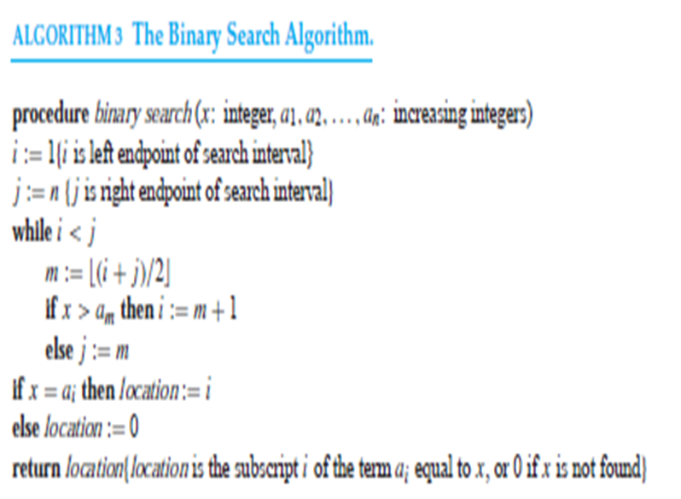
BINARY SEARCH

Slide 53
2.3 DIVIDE-AND-CONQUER RELATIONS
Example 2.3.1: Binary Search
What happen in Binary search:
  A subproblem is used: The algorithm reduces the search for an element in a search sequence of size n to the binary search for an element in a search sequence of size n/2, n even.
  g (n) : two comparisons are needed to implement this reduction
    to determine which half of the list to use
    to determine whether any terms of the list remain
If f (n) represents the number of comparisons required to search for an element in a search sequence of size n, then
  f (n) = a f (n/b) + g (n) = f (n/2) + 2 , n even
Notes:
BCT2083 DISCRETE STRUCTURE & APPLICATIONS
CHAPTER 2

Slide 54
2.3 DIVIDE-AND-CONQUER RELATIONS
Example 2.3.2: Maximum and Minimum
Locating the maximum and minimum elements of a sequence a1, a2, …, an:
  2 subproblems are used:
    If n = 1, then a1 is the maximum and minimum
    If n > 1, then the sequence split into 2 sequences ( either where both have the same number of elements or where one of the sequences has one ore element than the other), let say n/2
    The problem is reduced to find the maximum and minimum of each of the two smaller sequences
    The solution for original problem is the comparison result from these two smaller sequences
  g (n) : two comparisons are needed to implement this reduction
    to compare the maxima of two sequences
    to compare the minima of two sequences
If f (n) represents the total number of comparisons needed to find then maximum and minimum elements of the sequence with n elements, then
  f (n) = a f (n/b) + g (n) = 2f (n/2) + 2 , n even
Notes:
BCT2083 DISCRETE STRUCTURE & APPLICATIONS
CHAPTER 2

Slide 55
2.3 DIVIDE-AND-CONQUER RELATIONS
Example 2.3.3: Merge Sort
What happen in Merge Sort:
  Splits a list to be sorted with n items, where n even, into two lists with size n/2 elements each
  g (n) : uses fewer than n comparisons to merge the sorted lists of n/2 items each into one sorted list
Consequently, the number of comparisons used by the merge sort to sort a list of n element is less than M (n) where,
  M (n) = a f (n/b) + g (n) = 2 M (n/2) + n
Notes:
BCT2083 DISCRETE STRUCTURE & APPLICATIONS
CHAPTER 2

Slide 56
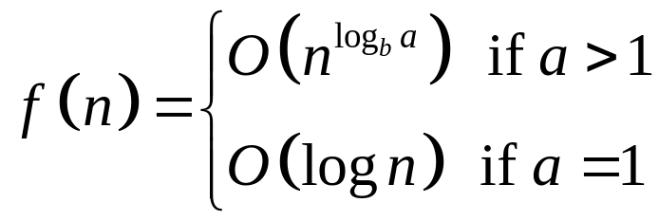

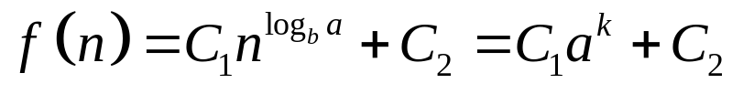
2.3 DIVIDE-AND-CONQUER RELATIONS
Theorem 1
Let a, b є N and c, d є R⁺ with b > 1. Let f be an increasing function that satisfies the recurrence relation f (n) = a f (n/b) + c and f (1) = d. Then
Furthermore, when , where k is a positive integer and a > 1;
where
Notes:
BCT2083 DISCRETE STRUCTURE & APPLICATIONS
CHAPTER 2

Slide 57

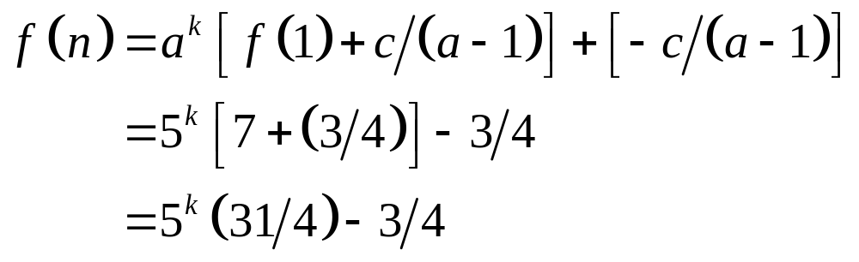
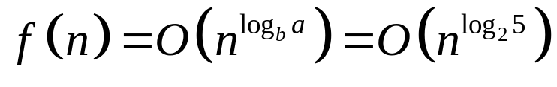
2.3 DIVIDE-AND-CONQUER RELATIONS
Example 2.3.4
Let f (n) = 5 f (n/2) + 3 and f (1) = 7. Find where k is a positive integer. Also estimate f (n) if f is increasing function
Solution:
a = 5, b = 2, c = 3, then
If f is increasing function,
Notes:
BCT2083 DISCRETE STRUCTURE & APPLICATIONS
CHAPTER 2

Slide 58
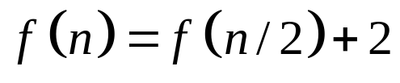
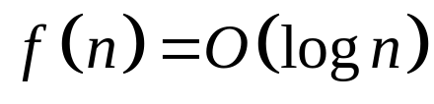
2.3 DIVIDE-AND-CONQUER RELATIONS
Example 2.3.5: Binary search
Estimate the number of comparisons used by binary search
Solution:
When n is even,
Where f is the number of comparisons required to perform a binary search on a sequence of size n. Hence,
Notes:
BCT2083 DISCRETE STRUCTURE & APPLICATIONS
CHAPTER 2

Slide 59
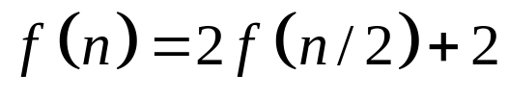
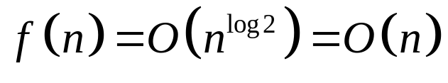
2.3 DIVIDE-AND-CONQUER RELATIONS
Example 2.3.6: maximum and minimum
Estimate the number of comparisons used to locate the maximum and minimum elements.
Solution:
When n is even,
Where f is the number of comparisons needed. Hence,
Notes:
BCT2083 DISCRETE STRUCTURE & APPLICATIONS
CHAPTER 2

Slide 60
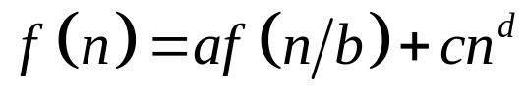
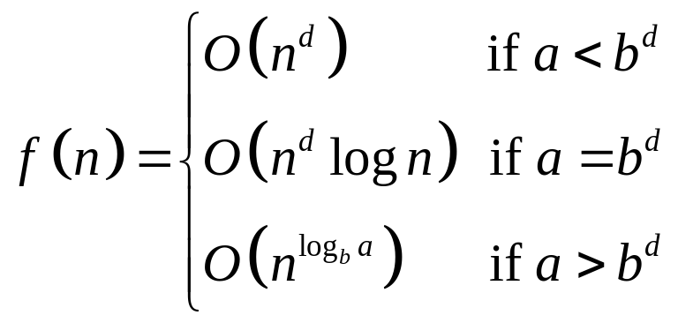
2.3 DIVIDE-AND-CONQUER RELATIONS
Master Theorem
Let a, b є N and c, d є R⁺ with b > 1. Let f be an increasing function that satisfies the recurrence relation
Then
whenever , where k is a positive integer
Notes:
BCT2083 DISCRETE STRUCTURE & APPLICATIONS
CHAPTER 2

Slide 61
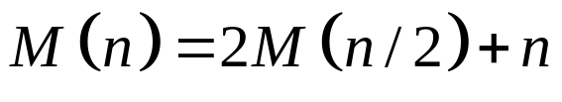
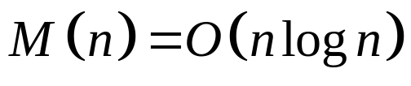
2.3 DIVIDE-AND-CONQUER RELATIONS
Example 2.3.7: Complexity of merge sort
Estimate the number of comparisons used by the merge sort to sort a list of n elements.
Solution:
The number of comparisons is less than M (n) where
Hence,
Notes:
BCT2083 DISCRETE STRUCTURE & APPLICATIONS
CHAPTER 2

Slide 62



2.2 SOLVING RECURRENCE RELATION
EXERCISE 2.3
Find f (n) when where f satisfies the recurrence relation f (n) = 2 f (n/3) + 1 with f (1) = 1. Estimate the solution f (n) if f is an increasing function.
Suppose that there are teams in an elimination tournament, where there are n/2 games in the first round, with the winners playing in the second round, and so on.
  How many rounds are in the elimination tournament when there are 32 teams?
  Use Divide-and-Conquer algorithm to develop a recurrence relation for the number of rounds in the tournament.
  Solve the recurrence relation.
Notes:
BCT2083 DISCRETE STRUCTURE & APPLICATIONS
CHAPTER 2

Slide 63
2.3 DIVIDE-AND-CONQUER RELATIONS
EXERCISE 2.3 : EXTRA
  PAGE : 482, 483 and 484
  Rosen K.H., Discrete Mathematics & Its Applications, (Seventh Edition), McGraw-Hill, 2007.
Notes:
BCT2083 DISCRETE STRUCTURE & APPLICATIONS
CHAPTER 2

Slide 64
CHAPTER 2 ADVANCE COUNTING TECHNIQUE
2.4 GENERATING FUNCTIONS
Represent a sequence as generating function
Solve counting problems using generating function
Solve recurrence relation using generating function
Notes:
BCT2083 DISCRETE STRUCTURE & APPLICATIONS
CHAPTER 2

Slide 65
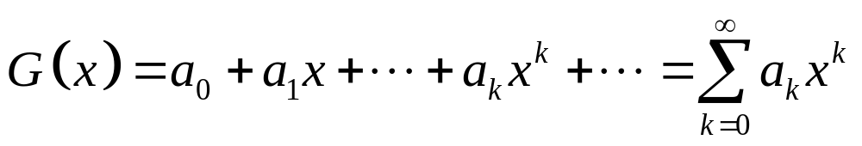
2.4 GENERATING FUNCTIONS
Generating Function of infinite Sequence
The generating function for the sequence a0, a1,…,ak,… of real numbers is the infinite series
REMARKS:
sometimes, this generating function for {ak} is called the ordinary generating function of ak
USEFUL GENERATING FUNCTIONS
refer hand-out or text book page 489 and 157
formal power series
Notes:
BCT2083 DISCRETE STRUCTURE & APPLICATIONS
CHAPTER 2

Slide 66
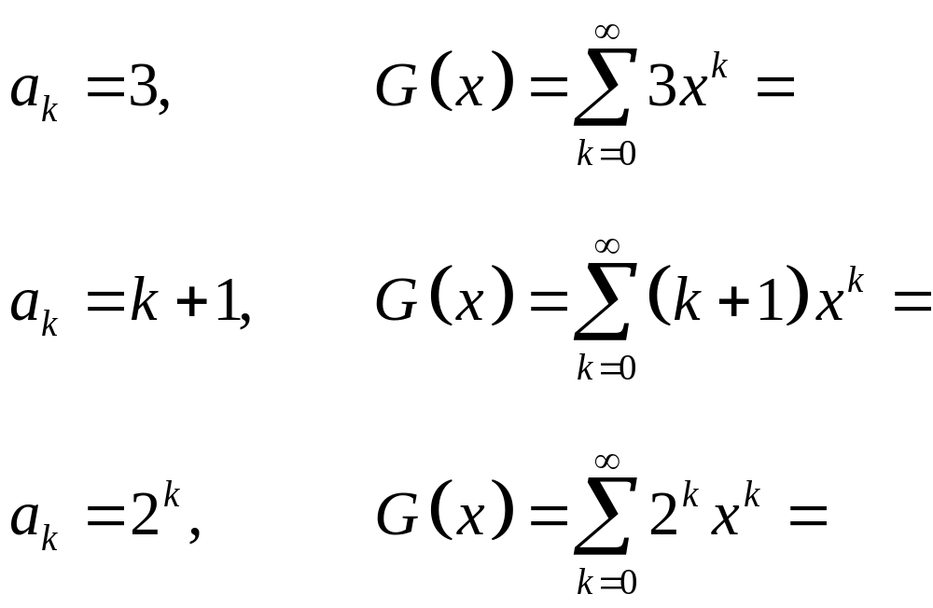
2.4 GENERATING FUNCTIONS
Example 2.4.1
The generating function for the following sequences {ak} are given by:
TIPS: refer handout
Notes:
BCT2083 DISCRETE STRUCTURE & APPLICATIONS
CHAPTER 2

Slide 67
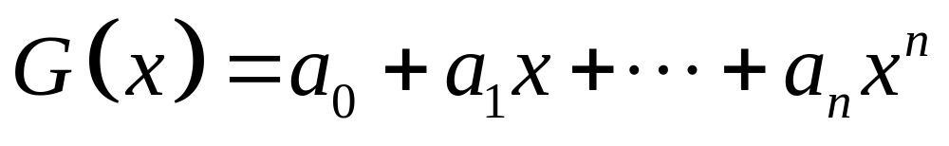
2.4 GENERATING FUNCTIONS
Generating Function of finite Sequence
The generating function for the finite sequence a0, a1,…,an of real numbers is define by
REMARKS:
the finite sequence is extend into an infinite sequence by setting an+1 = 0, an+2 = 0, and so on.
Notes:
BCT2083 DISCRETE STRUCTURE & APPLICATIONS
CHAPTER 2

Slide 68
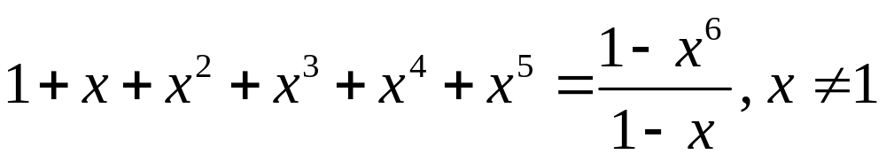

2.4 GENERATING FUNCTIONS
Example 2.4.2
The generating function for sequences 1,1,1,1,1,1 given by:
The generating function for sequences 1,1,1,1,1,1,… given by:
WHY?
WHY?
Notes:
BCT2083 DISCRETE STRUCTURE & APPLICATIONS
CHAPTER 2

Slide 69

THEOREM 01

Slide 70

THE BINOMIAL THEORWM

Slide 71


Slide 72


Slide 73

THE EXTENDED BINOMIAL THEORWM

Slide 74
2.4 GENERATING FUNCTIONS
TIPS: Types of questions
ak is given. Find G(x).
    Let m be a positive integer and ak = C(m,k), for k = 0, 1,…,m. What is the generating function for the sequence a0, a1,…, am?
A sequence of integers is given. Find G(x).
    Find the generating function for the finite sequence 1, 4, 16, 64, 256.
G(x) is given. Find the sequence of integers.
    A generating function of a sequence is given by (x²+1)³. Find the sequence.
Notes:
BCT2083 DISCRETE STRUCTURE & APPLICATIONS
CHAPTER 2

Slide 75


2.4 GENERATING FUNCTIONS
EXERCISE 2.4.1
  Find the generating function of the sequence 1, a, a², a³,…
  Find a closed form of generating function of infinite sequence 0, 1, -2, 4, -8, 16, -32, 64, …
  Find a closed form of generating function of infinite sequence
  Find a closed form for generating function for the sequence {an} where an = -1 and an = for all n = 0, 1, 2,…
  A generating function of a sequence is given by x² /(1 - x) ². Find the sequence.
Notes:
BCT2083 DISCRETE STRUCTURE & APPLICATIONS
CHAPTER 2

Slide 76
2.4 GENERATING FUNCTIONS
Counting Problems & Generating Functions
OBJECTIVE: Solve counting problem
1. to count the number of combinations of various types
2. to count the r-combinations from a set with n elements when repetition is allowed and additional constraints may exist
3. to count the solutions to equation of the form
e1 + e2 + . . . + en = C
where C is a constant
ei is a nonnegative integer that may subject to specified constraint
Notes:
BCT2083 DISCRETE STRUCTURE & APPLICATIONS
CHAPTER 2

Slide 77


2.4 GENERATING FUNCTIONS
Example 2.4.4
Find the number of solutions of e1 + e2 + e3 = 17, where e1, e2, and e3 are nonnegative integers with 2 ≤ e1 ≤ 5, 3 ≤ e2 ≤ 6, 4 ≤ e3 ≤ 7 .
Solution
From e1 + e2 + e3 = 17, we know that
So, the number of solutions with the indicated constraints is the coefficient of in the expansion of
Since the coefficient is 3, so there are ______ solutions.
HOW?
Notes:
BCT2083 DISCRETE STRUCTURE & APPLICATIONS
CHAPTER 2

Slide 78



2.4 GENERATING FUNCTIONS
Example 2.4.5
In how many different ways can eight identical cookies be distributed among three distinct children if each child receive at least two cookies and no more than four cookies?
Solution
Let e1 : child 1’s cookies, e2: child 2’s cookies, e3: child 3’s cookies
Each child receive at least two cookies and no more than four cookies, so 2 ≤ e1 ≤ 4, 2 ≤ e2 ≤ 4, and 2 ≤ e3 ≤ 4.
8 cookies is distributed among 3 children, so e1 + e2 + e3 = 8 where .
Thus the generating function is .
Since the coefficient of is ____, so there are ___ ways.
Notes:
BCT2083 DISCRETE STRUCTURE & APPLICATIONS
CHAPTER 2

Slide 79
2.4 GENERATING FUNCTIONS
EXERCISE 2.4.2
  Use generating functions to determine the number of ways to insert tokens worth RM1, RM5, and RM10 into a vending machine to pay for an item that cost RM r in both the cases when the order in which the tokens are inserted does not matter and when the order does matter.
  Use generating functions to find the number of ways to make change for RM100 using RM1, RM5, RM10 and RM50.
  Use generating functions to find the number of ways to select 14 balls from a jar containing 100 red balls, 100 blue balls, and 100 green balls so that no fewer than 3 and no more than 10 balls are selected from each color. Assume that the order in which the balls are drawn does not matter.
Notes:
BCT2083 DISCRETE STRUCTURE & APPLICATIONS
CHAPTER 2

Slide 80



2.4 GENERATING FUNCTIONS
Recurrence Relations & Generating Functions
OBJECTIVE: find a solution to a recurrence relation and its initial conditions by finding an explicit formula for the associated generating function.
TIPS:
Let G (x) be the generating function for the sequence {ak}, which
Change the sequence ak in the recurrence relation with G (x).
Solve for G (x).
and
Notes:
BCT2083 DISCRETE STRUCTURE & APPLICATIONS
CHAPTER 2

Slide 81



2.4 GENERATING FUNCTIONS
Example 2.4.6
Use generating functions to solve the recurrence relation ak = 3ak-1 for k = 1, 2, 3,… and initial condition a0 = 2.
Solution
By generating function, the recurrence relation ak = 3ak-1 become:
Solving for G (x):
Since .
Consequently;
Notes:
BCT2083 DISCRETE STRUCTURE & APPLICATIONS
CHAPTER 2

Slide 82


2.4 GENERATING FUNCTIONS
EXERCISE 2.4.2
  Use generating functions to solve the recurrence relation ak = 7ak-1 + 2 and initial condition a0 = 5.
  Use generating functions to solve the recurrence relation
  and initial condition a0 = 4 and a1 = 12.
  Suppose that a valid codeword is an n-digit number in decimal notation containing an even number of 0s. Let an denote the number of valid codewords of length n. The sequence {an} satisfies the recurrence relation and the initial condition a1 = 9. Use generating functions to find an explicit formula for an.
Notes:
BCT2083 DISCRETE STRUCTURE & APPLICATIONS
CHAPTER 2

Slide 83
2.4 GENERATING FUNCTIONS
EXERCISE 2.4 : EXTRA
  PAGE : 496, 497, 498 and 499
  Rosen K.H., Discrete Mathematics & Its Applications, (Seventh Edition), McGraw-Hill, 2007.
Notes:
BCT2083 DISCRETE STRUCTURE & APPLICATIONS
CHAPTER 2

Slide 84
CHAPTER 2 ADVANCE COUNTING TECHNIQUE
2.5 INCLUSION-EXCLUSION
Count the number of elements in the union of more than two sets.
Notes:
BCT2083 DISCRETE STRUCTURE & APPLICATIONS
CHAPTER 2

Slide 85


2.5 INCLUSION-EXCLUSION
The Principle of Inclusion-Exclusion
Let A1, A2, … An be finite sets. Then:
The number of elements in the union of the two sets A and B is:
The number of elements in the union of the three sets A, B and C is:
Notes:
BCT2083 DISCRETE STRUCTURE & APPLICATIONS
CHAPTER 2

Slide 86


2.5 INCLUSION-EXCLUSION
Example 2.5.1
Suppose that there are 1807 freshmen at your school. Of these, 453 are taking a course in computer science, 567 are taking a course in mathematics and 299 are taking course in both computer science and mathematics. How many not taking a course either in computer science or in mathematics?
Solution
Let A: The set of all freshmen taking a course in computer science
B: The set of all freshmen taking a course in mathematics
Then;
The number of freshmen taking a course either in computer science or in mathematics is
Thus, freshmen not taking a course either in computer science or in mathematics.
Notes:
BCT2083 DISCRETE STRUCTURE & APPLICATIONS
CHAPTER 2

Slide 87

2.5 INCLUSION-EXCLUSION
Example 2.5.2
A total of 1232 have taken a course in Spanish, 879 have taken a course in French and 114 have taken a course in Russian. Further, 103 have taken courses in both Spanish and French, 23 have taken courses in both Spanish and Russian, and 14 have taken courses in both French and Russian. If 2092 students have taken at least one of French, Spanish and Russian, how many students have taken a course in all three languages?
Solution
Let S: The set of students who taken a course in Spanish
F: The set of students who taken a course in French
R: The set of students who taken a course in Russian
Then;
The number of students have taken at least one of the languages is given by:
Thus, the number of students have taken a course in all three languages is:
Notes:
BCT2083 DISCRETE STRUCTURE & APPLICATIONS
CHAPTER 2

Slide 88
2.5 INCLUSION-EXCLUSION
EXERCISE 2.5
  How many positive integers not exceeding 1000 are divisible by 7 or 11?
  To help plan the number of meals to be prepared in a college cafeteria, a survey was conducted and the following data were obtained. 130 students takes breakfast, 180 students takes lunch, 275 students takes dinner, 65 students takes breakfast and lunch, 112 students takes breakfast and dinner, 98 students ate lunch and dinner, and 58 students takes all three meals. How many of the students Ate at least one meal in the cafeteria?
  How many elements are in the union of four sets if each of the sets has 100 elements, each pair of the sets shares 50 elements, each three of the sets share 25 elements, and there are 5 elements in all four sets?
Notes:
BCT2083 DISCRETE STRUCTURE & APPLICATIONS
CHAPTER 2

Slide 89
2.5 INCLUSION-EXCLUSION
EXERCISE 2.5 : EXTRA
  PAGE : 504 and 505
  Rosen K.H., Discrete Mathematics & Its Applications, (Seventh Edition), McGraw-Hill, 2007.
Notes:
BCT2083 DISCRETE STRUCTURE & APPLICATIONS
CHAPTER 2

Slide 90
CHAPTER 2 ADVANCE COUNTING TECHNIQUE
2.6 APPLICATION OF INCLUSION-EXCLUSION
Apply the inclusion-exclusion principle to solve various counting problem
Notes:
BCT2083 DISCRETE STRUCTURE & APPLICATIONS
CHAPTER 2

Slide 91


2.6 APPLICATION OF INCLUSION-EXCLUSION
An Alternative Form of Inclusion-Exclusion
AIM: Solve problem that ask for the number of elements in a set that have none of n properties P1, P2, …, Pn.
Let Ai: the subset containing the elements that have property Pi
- The number of elements with all the properties Pi1, Pi2, …, Pik will be denoted by N(Pi1, Pi2, …, Pik). In term of set, we have;
Let N(P1’, Pi’, …, Pi’): the number of elements in a set that have
none of n properties P1, P2, …, Pn
and N: number of elements in the set
- Thus;
From the inclusion-exclusion principle, we see that:
Notes:
BCT2083 DISCRETE STRUCTURE & APPLICATIONS
CHAPTER 2

Slide 92

2.6 APPLICATION OF INCLUSION-EXCLUSION
Example 2.6.1
How many solutions does x1 + x2 + x3 = 11 have where x1, x2, x3 are nonnegatives integers with x1 ≤ 3, x2 ≤ 4, and x3 ≤ 6?
Solution
Let a solution have property
P1 if x1 > 3
P2 if x2 > 4
P3 if x3 > 6
The number of solutions satisfying the inequalities x1 ≤ 3, x2 ≤ 4, and x3 ≤ 6 is
Notes:
BCT2083 DISCRETE STRUCTURE & APPLICATIONS
CHAPTER 2

Slide 93
2.6 APPLICATION OF INCLUSION-EXCLUSION
Example 2.6.1 : cont…
By combinations, it follows that:
N = total number of solutions = C (3+11-1, 11) = 78
N(P1) = (number of solutions with x1 ≥ 4) = C (3+7-1, 7) = 36
N(P2) = (number of solutions with x2 ≥ 5) = C (3+6-1, 6) = 28
N(P3) = (number of solutions with x3 ≥ 7) = C (3+4-1, 4) = 15
N(P1P2) = (number of solutions with x1 ≥ 4 and x2 ≥ 5) = C (3+2-1, 2) = 6
N(P1P3) = (number of solutions with x1 ≥ 4 and x3 ≥ 7) = C (3+0-1, 0) = 1
N(P2P3) = (number of solutions with x2 ≥ 5 and x3 ≥ 7) = 0
N(P1P2P3) = (number of solutions with x1 ≥ 4, x2 ≥ 5 and x3 ≥ 7) = 0
Thus number of solutions satisfying the inequalities x1 ≤ 3, x2 ≤ 4, and x3 ≤ 6 is
C(n+r-1, r)
Notes:
BCT2083 DISCRETE STRUCTURE & APPLICATIONS
CHAPTER 2

Slide 94

2.6 APPLICATION OF INCLUSION-EXCLUSION
Example 2.6.2: The Sieve of Eratosthenes
Find the number of prime not exceeding a specified positive integers (ex: 100)
Solution
CLUE: Composite integers not exceeding 100 must have a prime factor not exceeding 10 (WHY?); 2, 3, 5 and 7.
Let a solution have property
P1 if an integer is divisible by 2
P2 if an integer is divisible by 3
P3 if an integer is divisible by 5
P4 if an integer is divisible by 7
The number of prime not exceeding 100 is
Notes:
BCT2083 DISCRETE STRUCTURE & APPLICATIONS
CHAPTER 2

Slide 95


2.6 APPLICATION OF INCLUSION-EXCLUSION
Example 2.6.2: Cont…
Because there are 99 positive integers greater than 1 and not exceeding 100, the principle of inclusion-exclusion shows that:
Thus, the number of prime not exceeding 100 is
Notes:
BCT2083 DISCRETE STRUCTURE & APPLICATIONS
CHAPTER 2

Slide 96

2.6 APPLICATION OF INCLUSION-EXCLUSION
Example 2.6.3: The Number of Onto Functions
Let m and n be positive integers with m ≥ n. Then there are
onto functions from a set with m elements to a set with n elements
How many onto functions are there from the set with 6 elements to a set with 3 elements?
Solution
Suppose that the elements in the codomain are b1, b2, and b3. Let P1, P2 and P3 be the properties that b1, b2, and b3 are not in the range of the function, respectively. Thus, the number of onto functions is
Notes:
BCT2083 DISCRETE STRUCTURE & APPLICATIONS
CHAPTER 2

Slide 97


2.6 APPLICATION OF INCLUSION-EXCLUSION
Example 2.6.4: Derangements
A derangement is a permutation of objects that leaves no object in its original position.
The permutation 21453 is a derangement of 12345 because no number left in its original position.
21543 is not a derangement of 12345 because this permutation leaves 4 in fixed position.
The number of derangements of a sets with n elements is
The probability of a derangement is
Notes:
BCT2083 DISCRETE STRUCTURE & APPLICATIONS
CHAPTER 2

Slide 98
2.6 APPLICATION OF INCLUSION-EXCLUSION
EXERCISE 2.6 :
Find the number of solutions does the equation x1 + x2 + x3 + x4 = 17 have where x1, x2, x3 , x4 are nonnegatives integers with x1 ≤ 3, x2 ≤ 4, and x3 ≤ 5 and x4 ≤ 8 ?
How many ways are there to assign five different jobs to four different employees if every employee is assigned at least one job?
A new employees checks the hats of n people at a restaurant, forgetting to put claim check numbers on the hats. When customers return for their hats, the checker gives them back hats chosen at random from the remaining hats. What is the probability that no one receive the correct hats?
Notes:
BCT2083 DISCRETE STRUCTURE & APPLICATIONS
CHAPTER 2

Slide 99
2.6 APPLICATION OF INCLUSION-EXCLUSION
EXERCISE 2.6 : EXTRA
  PAGE : 512 and 513
  Rosen K.H., Discrete Mathematics & Its Applications, (Seventh Edition), McGraw-Hill, 2007.
Notes:
BCT2083 DISCRETE STRUCTURE & APPLICATIONS
CHAPTER 2

Slide 100
THANK YOU
Notes:
BCT2083 DISCRETE STRUCTURE & APPLICATIONS
CHAPTER 2

